Slide 1
Hate Crime Analysis
Team 8
Sajani Menon, Parin Mody,
Asher Brown , Radha Mahalingam

Slide 2
Motivation & Summary
Motiva
Chase our passion for a safe haven and use
AI (our brains)
to predict high crime locations.
Our observations include:
Hate crime has been on the rise from 2014 to 2017.
Summer months were clearly active months for crime, making winter months relatively safer.
Data showed no correlation between Unemployment and
crime count . Also, increase in crime count did not always translate
into the hiring of more police officers to combat crime.
Residential Areas stood out as prime location areas for crime.
Hate Crime
Analysis
Data Set Range – 2014 to 2017 , 50 US States

Slide 3
Research Questions
Do we see a trend in crime rate?
Can we predict safer months?
Do we hire more police officers to combat crime?
Where do most crimes occur? How should police plan their patrol locations?
CA has a higher crime rate than NY and Ohio. Can we say the same for the major cities within these states ?
t – test on crime data comparing Population to Sample means
Does unemployment raise crime?
1
2
3
4
5
6
7

Slide 4
Research Data
Hate Crime Dataset:
The Hate Crime Statistics dataset provides annual statistics on the number of incidents, offenses, victims, and offenders in reported crimes that are motivated in whole, or in part, by an offender’s bias against the victim’s perceived race, gender, gender identity, religion, disability, sexual orientation, or ethnicity.
URL : https://crime-data-explorer.fr.cloud.gov/downloads-and-docs
Police Employee Dataset: The Police Employee dataset is made up of data collected annually about law enforcement officers and civilians employed by law enforcement agencies. The dataset contains information about the number of officers and civilians employed and the rate of police employees per a location’s population.
URL : https://crime-data-explorer.fr.cloud.gov/downloads-and-docs
Unemployment Dataset:
URL(CA):https://www.labormarketinfo.edd.ca.gov/cgi/dataanalysis/AreaSelection.asp?tableName=labforce
URL(NY): https://fred.stlouisfed.org/series/NYUR
URL(OH): https://fred.stlouisfed.org/series/OHUR

Slide 5
Our Data Analysis Journey
Motiva
Data Cleanup and Exploration
Observe Correlation
Crime count v/s Unemployment
Observe
Offense Trend
State v/s
Major Cities
Identify
Top 3 States
By Crime
Analyze
Overall Crime Trend
Predict
Safe Months
Observe
Correlation
Crime Count v/s
Officer Count
Provide a Police Patrol Plan

Slide 6
Data Cleanup and Exploration
Motiva
Exploration/Clean Up:
Explored 3 different URLS to gather unemployment rate information.
Dropped header row.
Removed & renamed columns; filled null values with 0
Insights:
Too many specific categories for types of offenses.
Too many specific locations where the crimes occurred.
Technical Challenges:
Hate Crime Data Set:
NY crime area provided too many unknown locations.
Unemployment Data Set:
Original unemployment rate CSV only included California.
Difficulty merging data within rows and columns – Transpose.
Police Employee Data Set
Difficulty creating grouped data bar chart.

Slide 7
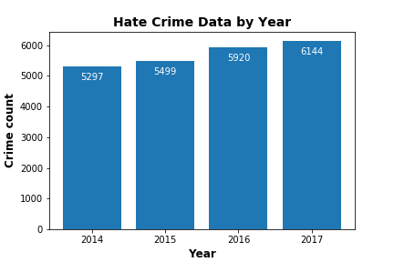
Story Line
Motiva
Do we see a trend in hate crime rate?
Activities Performed:
1.Used Hate Crime Dataset
2. Includes all 50 states
3. Observed YoY hate crime trend for
4 years
Observation : (YoY) Crime Rates are on the
rise

Slide 8
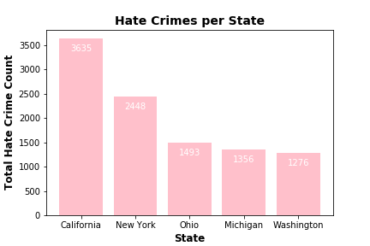
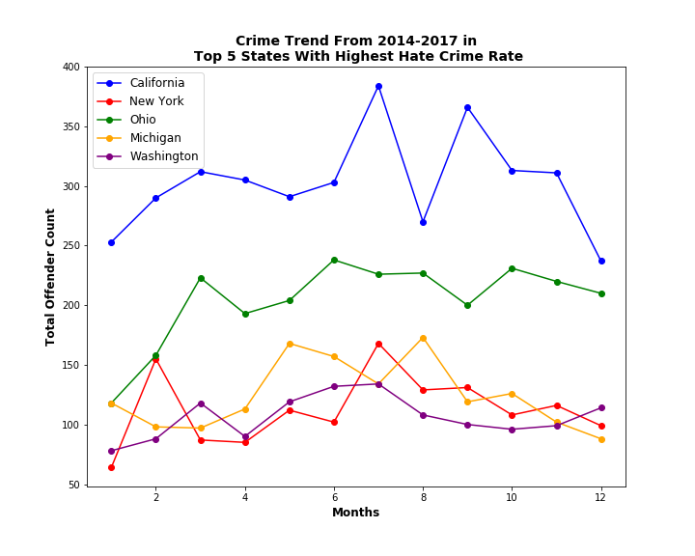
Story Line
Do we see safe months?
Motiva
Activities Performed:
1
1. Identified top 5 states by crime.
2. Evaluated the sample set.
3. CA , NY and OH seemed to be a reasonable data sample
4. Added a new column “Month”, to analyze trend by month
2
Observation : 1. Safe months : Dec to Jan.
2. Unsafe months : June to Aug

Slide 9
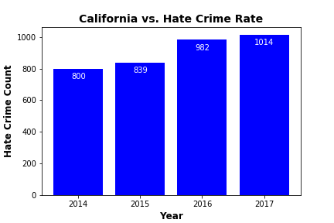
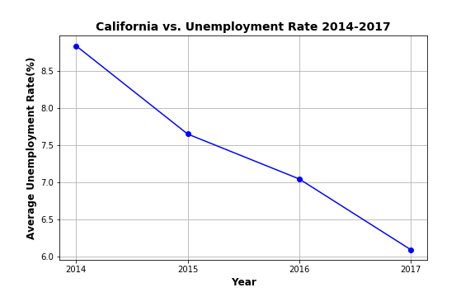
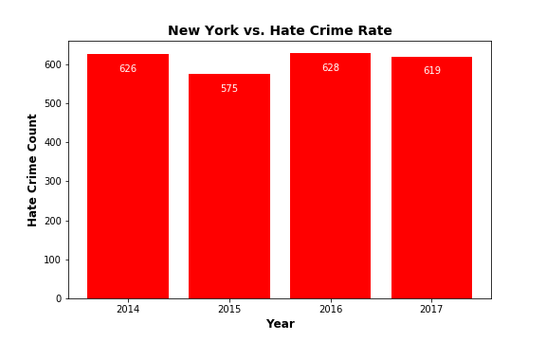
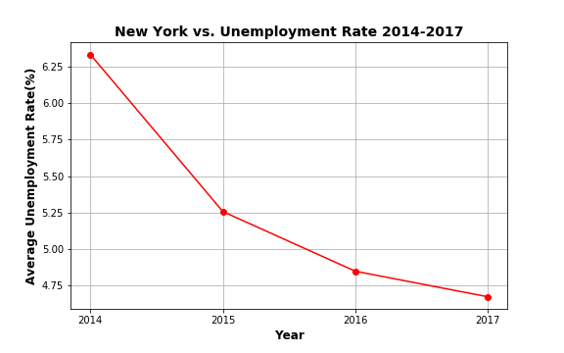
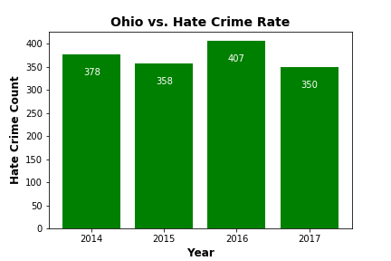
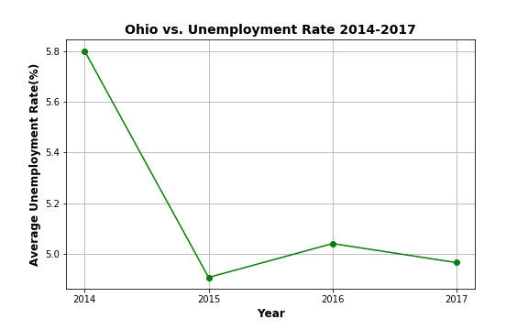
Story Line
Does unemployment raise crime?
Motiva
Activities Performed:
Used two datasets – Hate crime and Unemployment
Continued using the top 3 states on crime for sampling. CA,NY and OH
Charts show
# of hate crimes by Year and
Unemployment rate by Year
4. 2017 data surprises us.
Observation : 2017 shows high crime count BUT low unemployment rate . SHOCKER

Slide 10
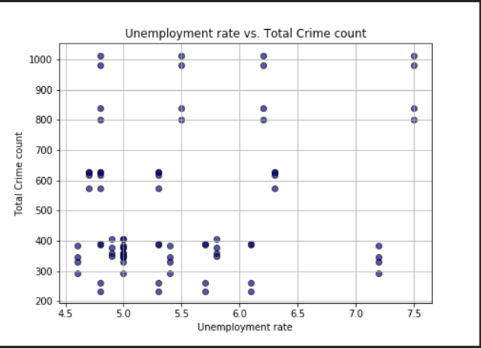
Story Line
Is there a correlation between crime and unemployment?
Motiva
Activities Performed:
Merged datasets – Hate crime and Unemployment
Data set limited to top 5 states by crime
Merge involved challenges like ‘Transpose’
- Unemployment csv had the states
drilled across.
- Crime csv had the states vertically laid
out.
4. Chart shows
Unemployment rate v/s Crime count
Observation : No Trend observed, no
correlation

Slide 11
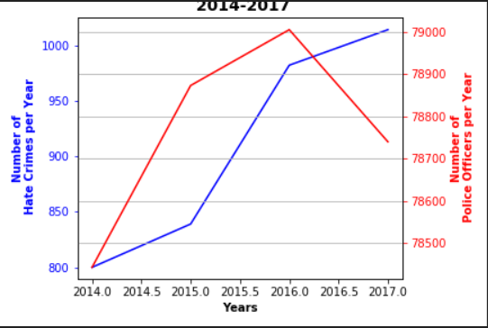
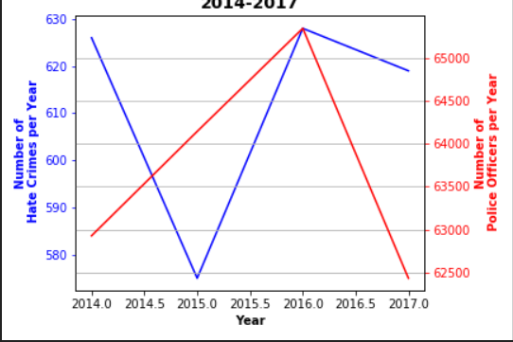
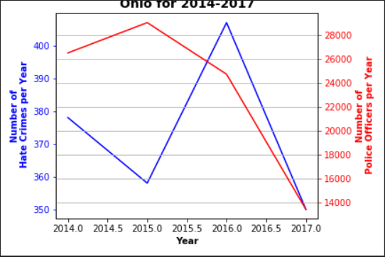
Story Line
Motiva
Do we hire more officers to combat crime ?
CA
Activities Performed:
Used stack overflow to create a dual chart
Picked top 3 states on crime for sampling.
Charts show
# of hate crimes v/s # of officers by yr
NY
OH
Observation : 2017 shows a drastic decrease in police force inspite of a crime rate increase

Slide 12
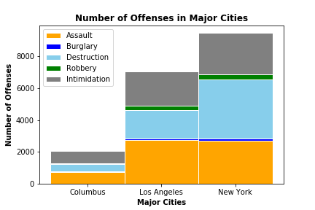
Story Line
CA has a higher crime rate than NY and Ohio. Can we say the same for the top cities?
Motiva
Activities Performed:
1. Identified top 5 states by crime.
2. Evaluated the sample set.
3. CA , NY and OH seemed to be a reasonable data sample
4. Created broader category bins for offense types
6. Used stack overflow to create stacked bar chart
1
1
Observation : CA tops in crime count but the same is not true for LA compared to NY city.

Slide 13
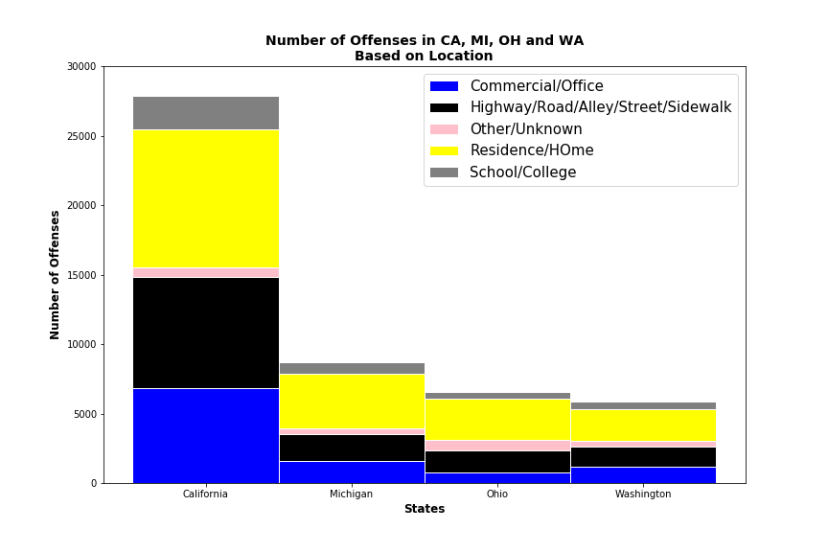
Story Line
Motiva
Can we provide a police patrol plan ?
Activities Performed:
1.Used Hate Crime Dataset
2. Sample includes top 4 states
3. Had to exclude NY because of vague information related to crime locations
4.Created higher level bins for grouping of crime locations.
Observation : Residential Areas clearly stand out and need more police patrolling.

Slide 14
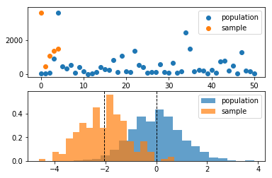
Story Line
T Test
Population definition:
Total crime data for all 50 states for the period from 2014 through 2017
Sample definition:
Total crime data for selected five states ((CA, MA, OH, MI, CO) for the period from 2014 through 2017.
Problem Statement:
We obtained the crime rate statistics as part of the population (All US states for the period from 2014 to 2017. As part of a social engineering exercise, the federal government wanted to invest in specific job training programs to improve employment opportunities and see if this investment has a positive or negative effect on crime rate or no effect at all.
A sample of five states have been selected, where specific programs have been run to improve the employment opportunities. These states were (CA, MA, OH, MI, CO). Did the investment in the job training programs affect the crime rate?
Null and alternate hypothesis
Null Hypothesis:
H0 : Sample mean = Population mean (i.e. the investment in job training did not affect the crime rate) Alternate Hypothesis:
H1: Sample mean not = Population mean (i.e. the investment in job training did affect the crime rate)
State Alpha (confidence level)
0.05 (95% confidence level)
Calculate degrees of freedom
Number of states in the sample = 5. That means the degrees of freedom = 5-1 = 4
Results :(test statistics and p_value) computed using stats.ttest_1samp from scipy library
statistic=2.144272939863221, pvalue=0.09861344955296641
Conclusion
Since p>0,05, we accept the null hypothesis that the population and sample means are equal. That means, the investment in the job training did not affect the crime rate.

Slide 15
Post Mortem
Discuss any difficulties that arose, and how you dealt with them
Difficulty:
Face to face meetings outside class hours were challenging.
Solution:
Had to resort to phone calls and Webex sessions.
Discuss any additional questions that came up, but which you didn't have time to answer: What would you research next, if you had two more weeks?
Introduce Juvenile crime data
Juvenile crime rate v/s Adult crime rate by State
Can a higher adult crime rate predict higher % of juveniles becoming adult criminals?
Introduce another dimension – Race
Does the data provide evidence of higher inter-racial hate crimes ?

Slide 16
Q & A

